Slide 1
National Healthcare Safety
Network Data Sets
Nevada HAI Task Force | February 16, 2018
Donna S. Thorson, MS, CPHQ, CPPS | senior project manager, HealthInsight

Slide 2
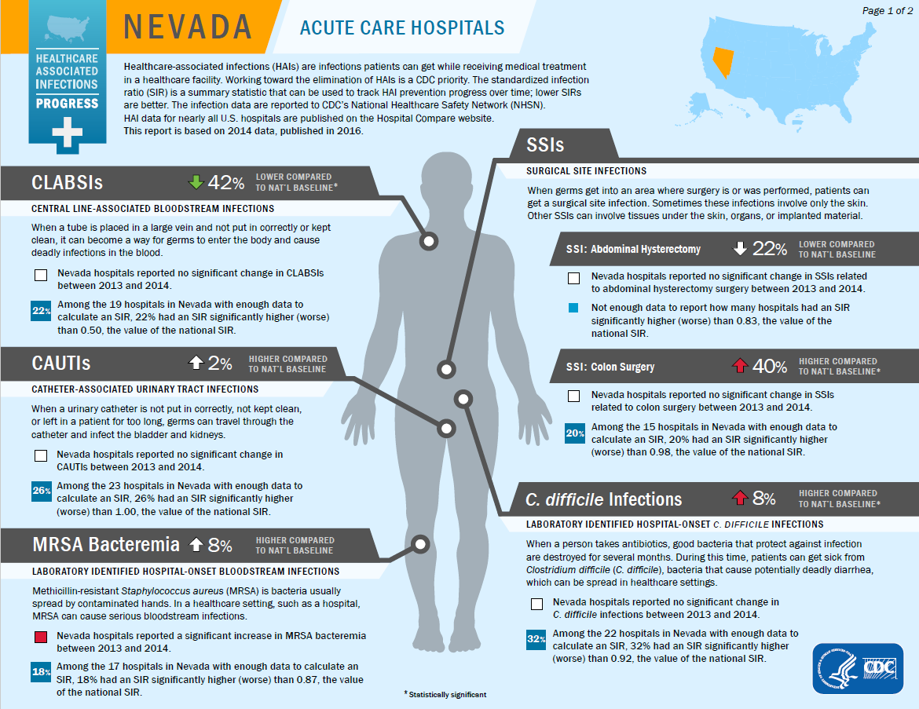
NHSN 2014 Data

Slide 3
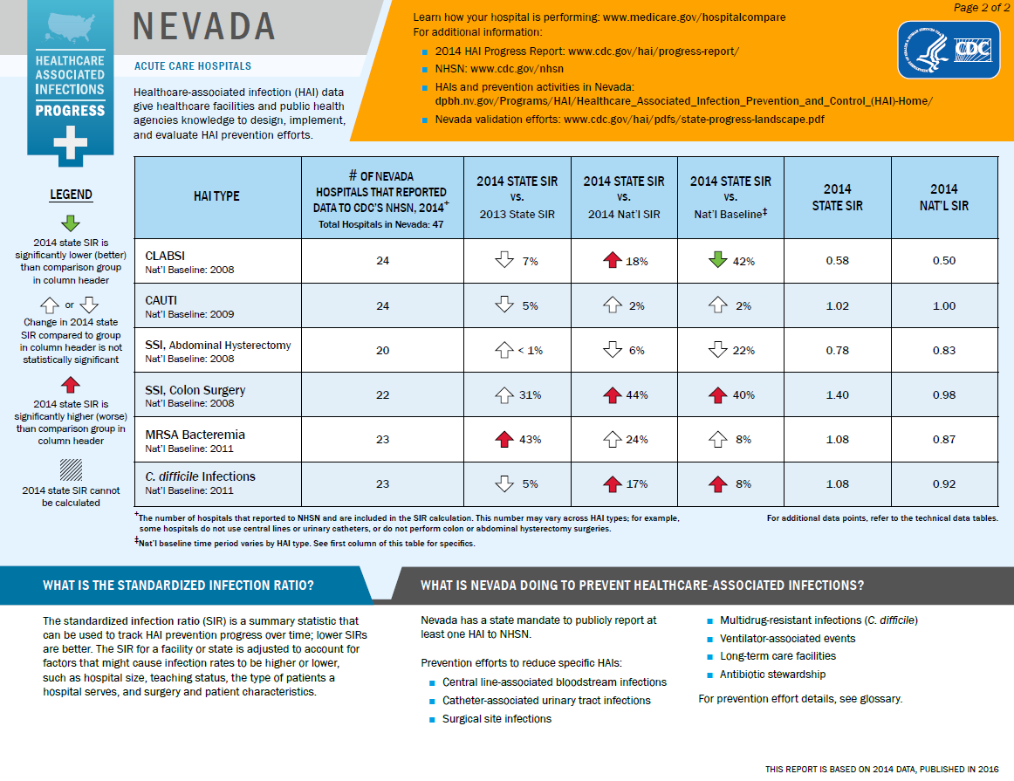
NHSN 2014 Data

Slide 4
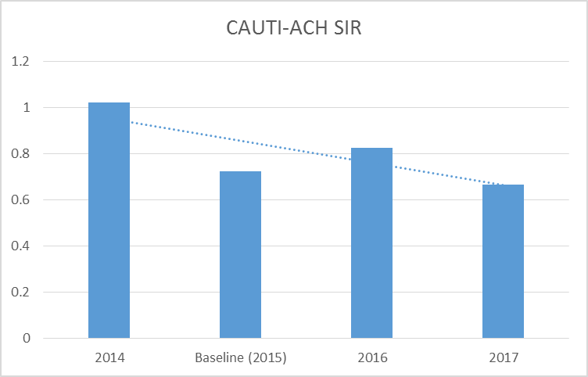
ACH Catheter Associated
Urinary Tract Infection (UTI)
NHSN Data set generated 1/25/2018

Slide 5
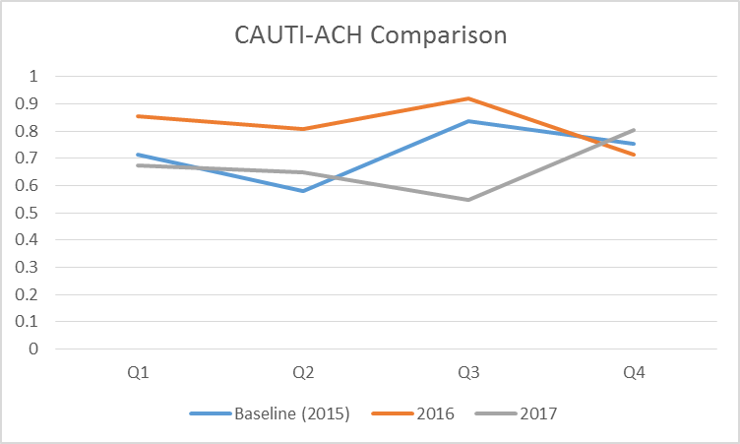
Quarter-by-Quarter Comparison
NHSN Data set generated 1/25/2018

Slide 6
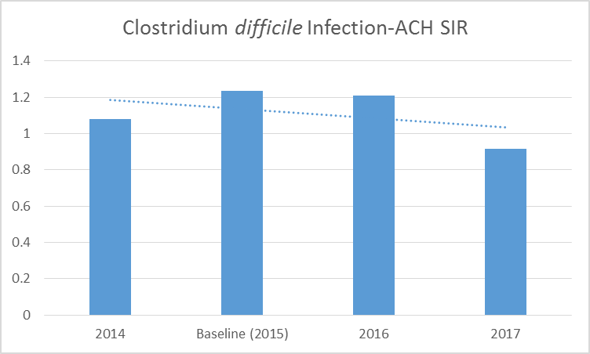
ACH C. difficile Infection
NHSN Data set generated 1/25/2018

Slide 7
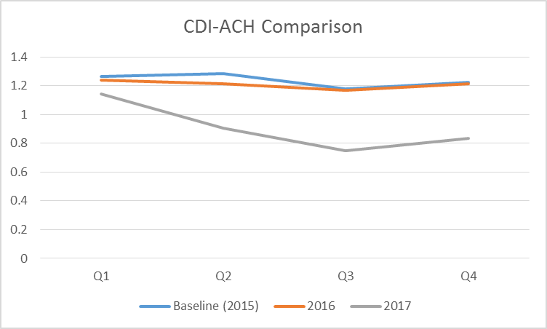
Quarter-by-Quarter Comparison
NHSN Data set generated 1/25/2018

Slide 8
Contact Information
Donna S. Thorson
dthorson@healthinsight.org
702-933-7327
This material was prepared by HealthInsight, the Medicare Quality Innovation Network -Quality Improvement Organization for Nevada, New Mexico, Oregon and Utah, under contract with the Centers for Medicare & Medicaid Services (CMS), an agency of the U.S. Department of Health and Human Services. The contents presented do not necessarily reflect CMS policy. 11SOW-CORP-18-18-NV

